Slide 1
A how-to for forensics maths
Epochs and hex’s

Slide 2
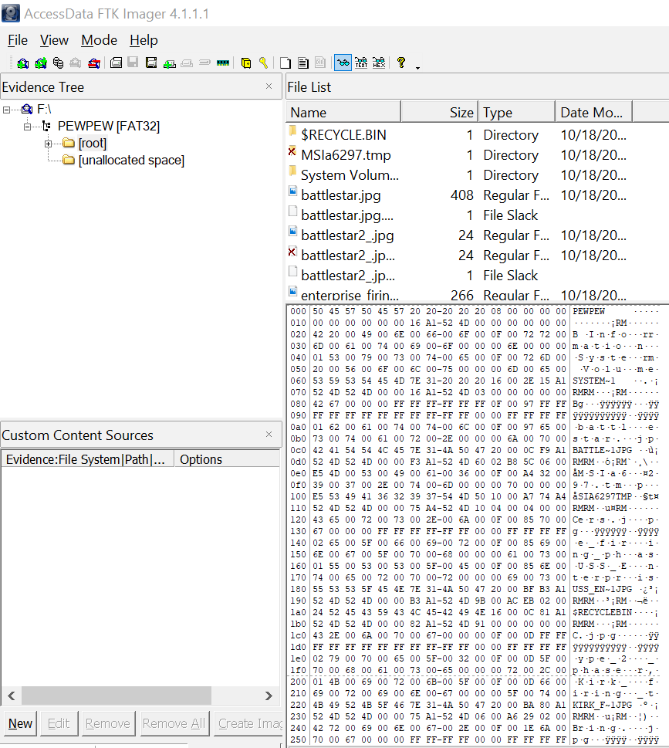
FAT32 filesystem
Load a FAT32 image, PHYSICAL or Logical drive to FTK Imager and select the [root] element in the hierarchy.
Notice the files in the root, but don’t click on any of them.
You should see the entries for the files in raw hex and ASCII below the File List.

Slide 3
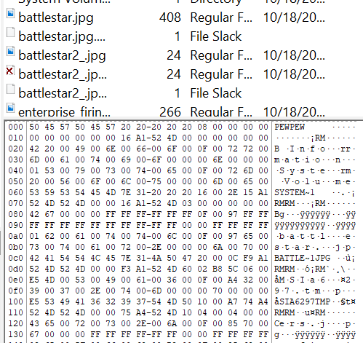
Let’s consider one file
We can see the short file name of Battlestar.jpg in the ASCII view of the raw data. From the first character of the name, count from right to left, continuing on the next line to 20 bytes. (Bytes are paired hex values in this view) Each row is 16 bytes long.

Slide 4

Dates/times
22 bytes in is the two byte value for modified TIME in FAT32. The next two bytes are modified DATE . Notice the Created DATE/TIME prior to this.

Slide 5
CALCulate
F3A1 524D is our value.
Remember reverse byte orders.
F3 A1 52 4D
A1 F3 4D 52
HEX to Binary (because FAT32 epoch is stored as a binary value!!!)

Slide 6
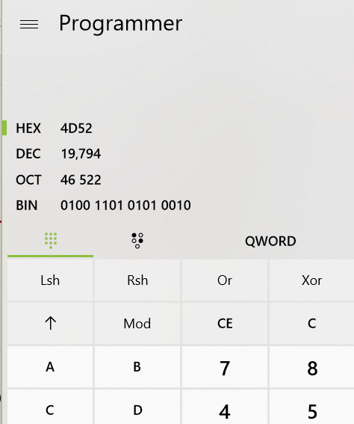
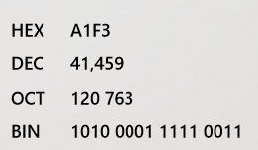
calculate
Open the calculator and change to programmer mode.
Enter the value in the HEX field.
The first 7 digits in binary are the number of years since 1980.
The next 4 are the month.
The remaining 5 are the day.

Slide 7
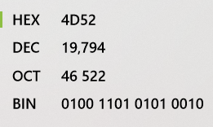
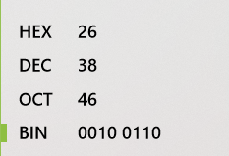
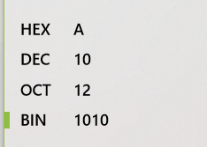
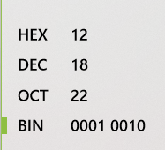
Convert

Slide 8
What day is it? October?
So the date is 1980 + 38 = 2018 and our day/month were 18/10 so it’s October the 18th of 2018!
How about the time?

Slide 9
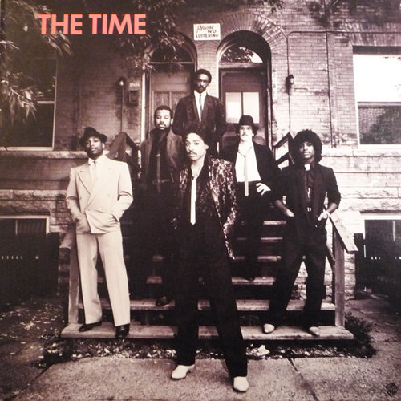
The time

Slide 10
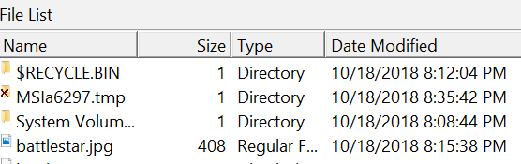
Not Morris day… what’s the file’s mod time?
Use the same process
A3F1 is ‭1010000111110011‬
Why do we take the first 5 for hour? Because 2^4 is 16, 2^5 is 32 and you need at least 0-23.
How about minutes? 2^6 is 64 and you need at least 0-59
The hour is 10100 = 20 which is 8pm
The minute is 001111 = 15
8:15 pm!!

Slide 11
Seconds?
10011 is 19 though? What gives?
FAT32 time granularity is 2 seconds. So double the time to 38.

